Slide 2
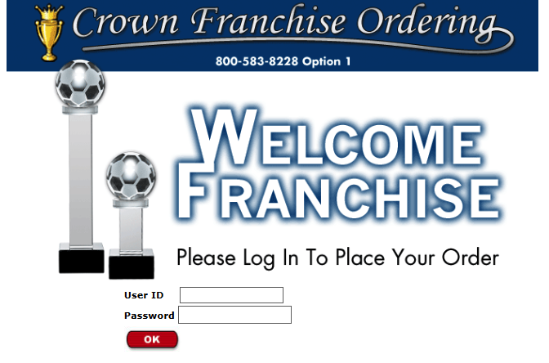
Crown Awards and Crown Trophy working together to make a better, streamlined, more user friendly online ordering site

Slide 3
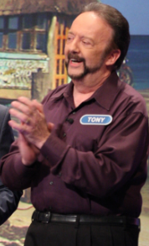
YOUR Suggestions…
Additional Ship Via Option for TRUCK
Programming required
For Now, call Tony Raio…
Add Crown Trophy Style # Below Crown Awards Style #
Apply the CT Style # in IMS
COMPLETE!

Slide 4
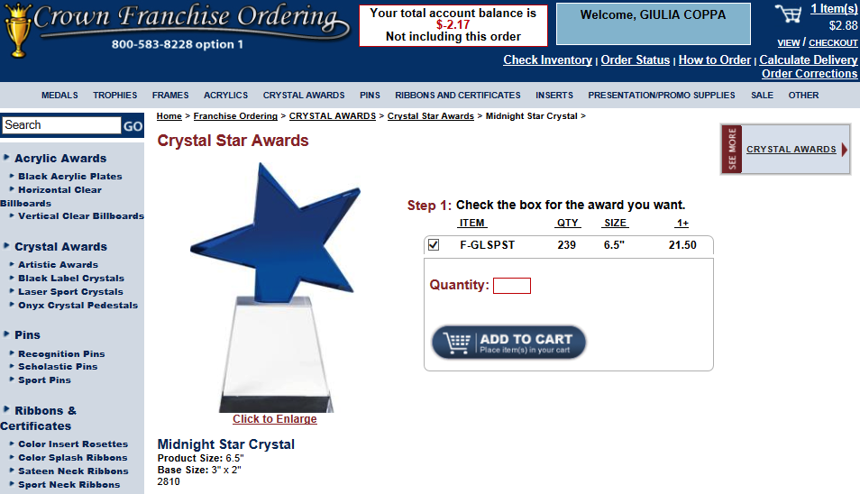
YOUR Suggestions…
Crown Trophy Style #: 2810

Slide 5
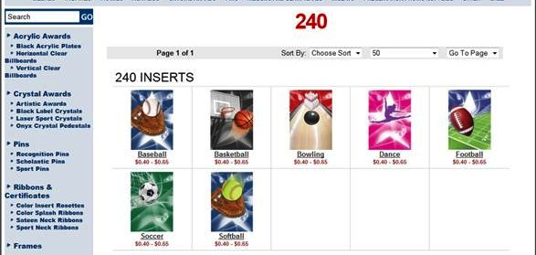
YOUR Suggestions…
Search
Completed

Slide 6
YOUR Suggestions…
Is there a possibility of operating 2 shopping carts?
YES!! How?
separate Log-in that will link to the same master account
In Testing
If you would like this set up for your account, please Email Us at: gcoppa@crownawards.com

Slide 7
YOUR Suggestions…
To have a back order basket and ETA of out of stock items
We will work on posting the ESTIMATED Time of Arrival on Franchise ordering. There will be a link to the OOS report that is updated daily.

Slide 8
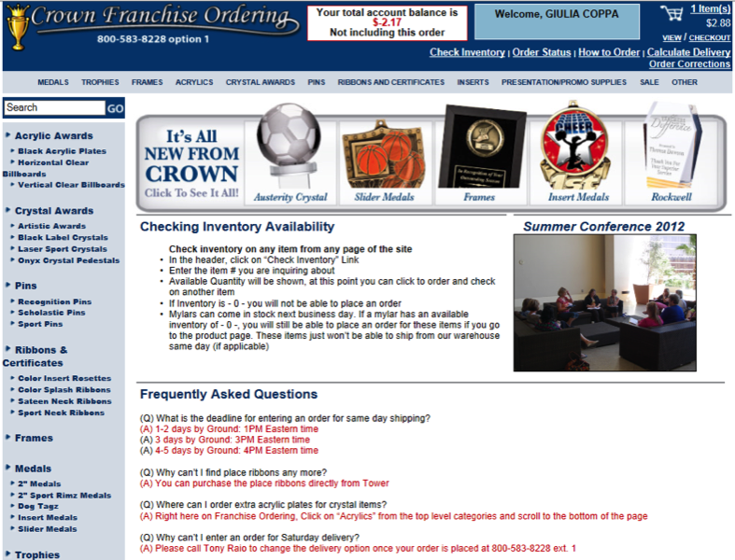
YOUR Suggestions…
ETA OOS (continued)
We will keep you updated!
Out of Stock |

Slide 9
YOUR Suggestions…
Comment box on the shopping cart page per item
YES! Programming required and we are working on it
WE WILL KEEP YOU POSTED!

Slide 10
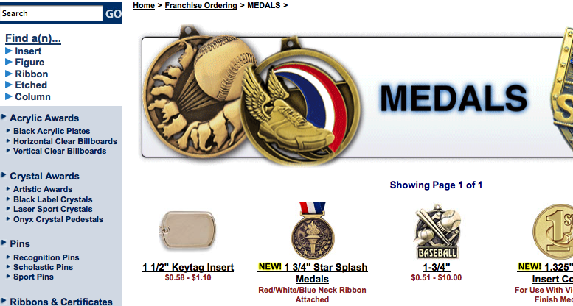
YOUR Suggestions…
Login without prices?
We will add finders starting with mylars, ribbons, columns
COMPLETE!

Slide 11
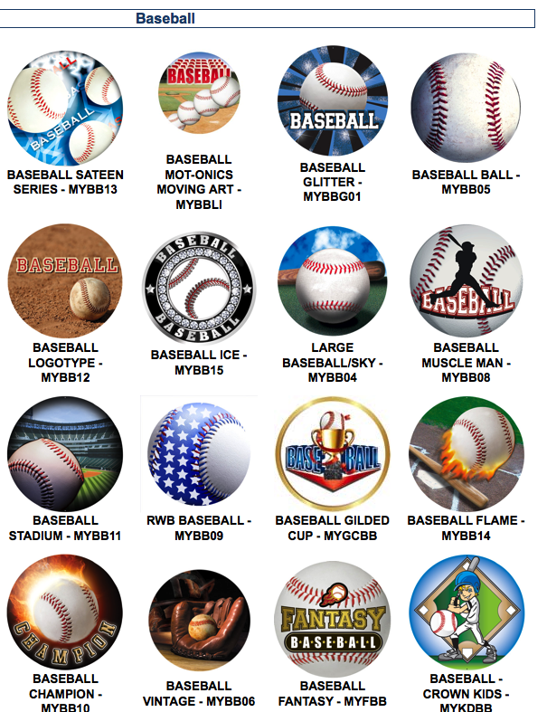
YOUR Suggestions…
Finders
Insert finder example
NO PRICES
NO LINKS
ALL OPTIONS

Slide 12
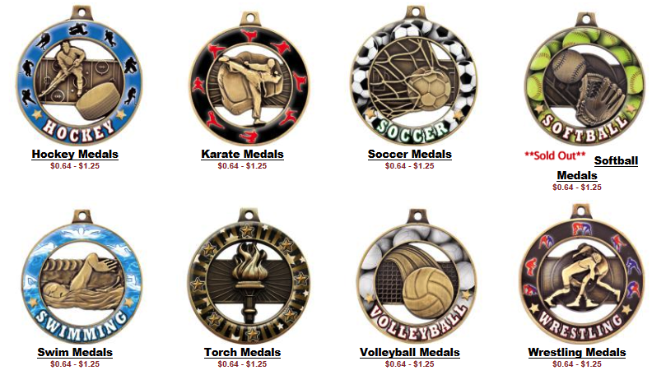
YOUR Suggestions…
Flag OOS items
Complete

Slide 13
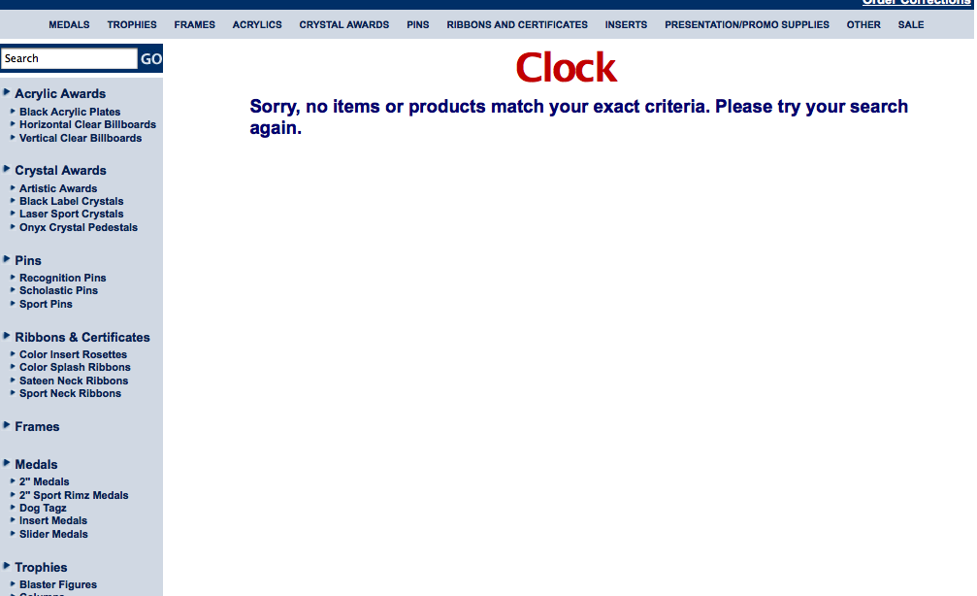
YOUR Suggestions…
Improving search terms
COMPLETE!
Before…

Slide 14
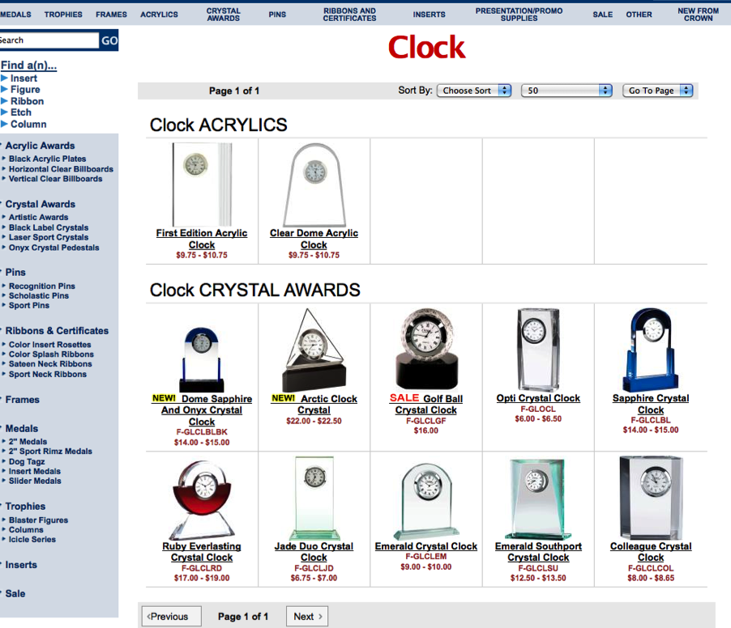
YOUR Suggestions…
NOW…

Slide 15
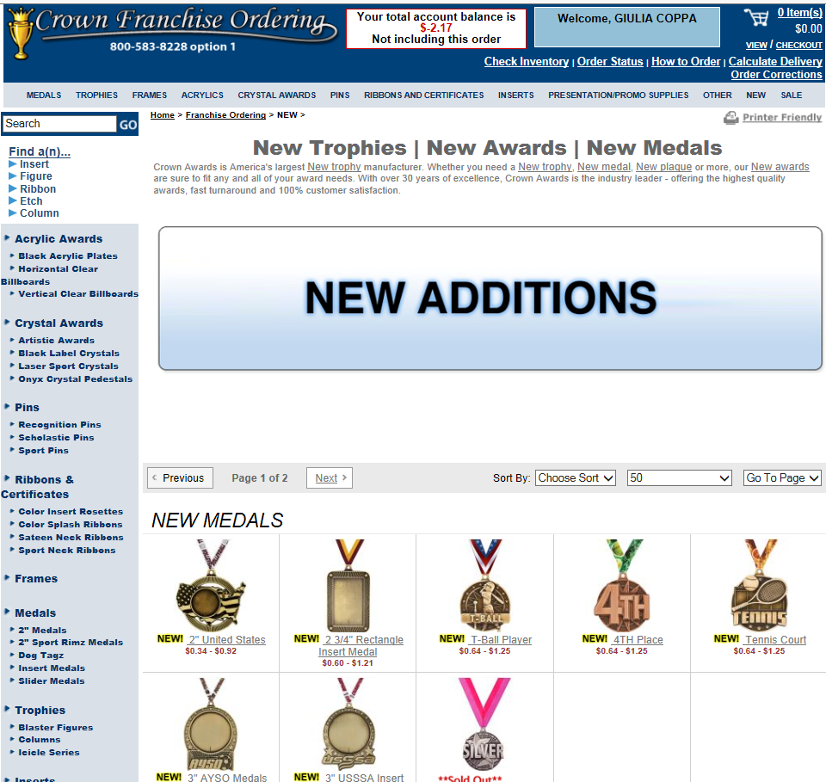
YOUR Suggestions…
A NEW Category!
A category that will dynamically populate based on the NEW image
Complete

Slide 16
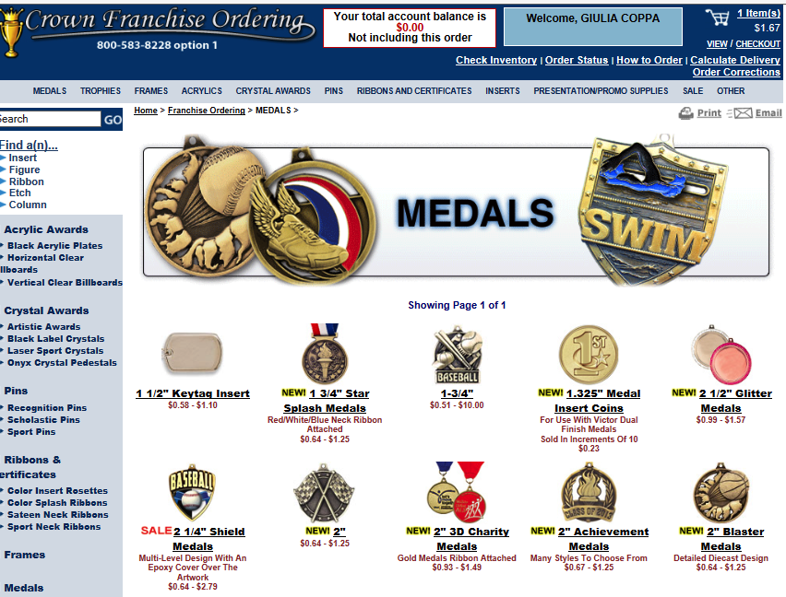
YOUR Suggestions…
Printer Friendly Link
Link on Category, Subcategory, Product pages and Shopping cart
COMPLETE

Slide 17
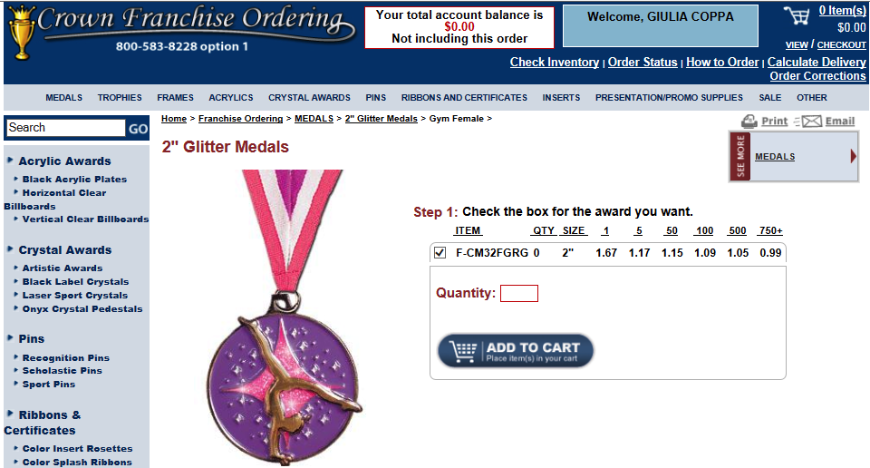
YOUR Suggestions…
Printer Friendly Link

Slide 18
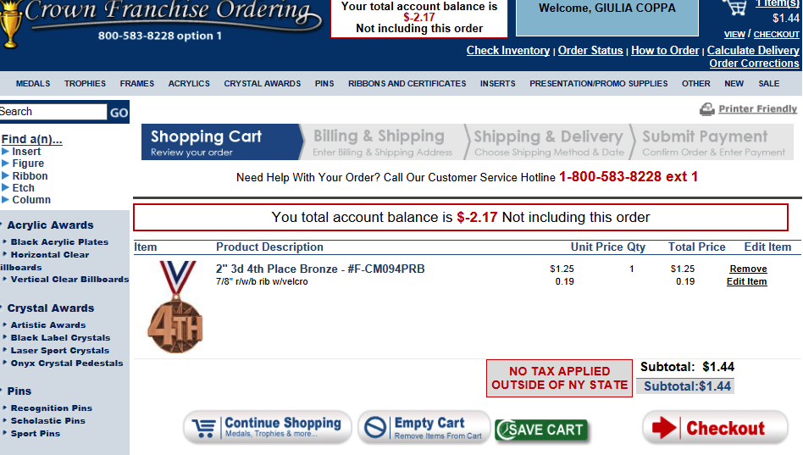
YOUR Suggestions…
Printer Friendly Link

Slide 19
YOUR Suggestions…
Add a couple minutes past the cutoff time for last minute orders
COMPLETE
Override the “Search” word when click in the search box
The site does this already.

Slide 20
YOUR Suggestions…
Sell items as they come packed
YES, this is the goal! We will come up with a better procedure internally for the package changes and how we can better implement the change for you!
Auto Save Shopping cart vs manual save
The site does this already. All items in the shopping cart are saved for 30 Days.

Slide 21
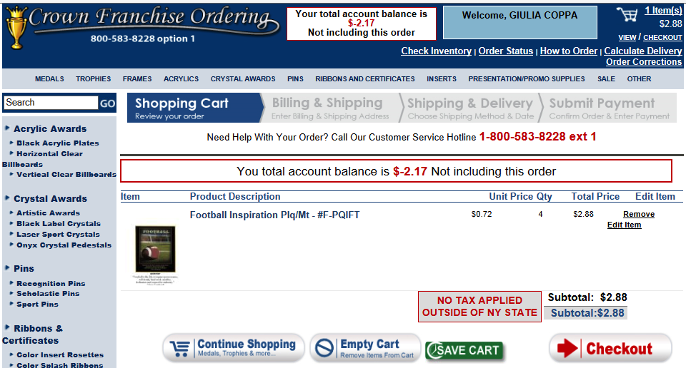
YOUR Suggestions…
Auto Saved Shopping Cart (Cont)

Slide 22
YOUR Suggestions…
Laser Settings for Crystal Confusion
Completed!
Item F-LUFR68 - black background is a flexi?
Complete! We have updated the image and added the IMS

Slide 23
YOUR Suggestions…

Slide 24
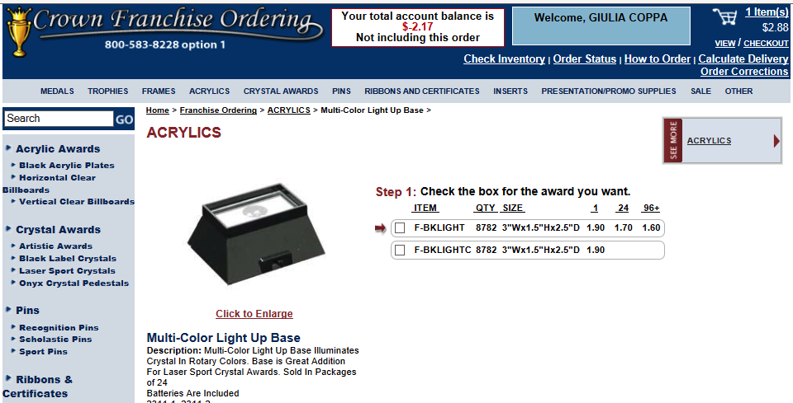
YOUR Suggestions…
Item F-BKLIGHT – are batteries included?
Complete! Added to IMS

Slide 25
YOUR Suggestions…
Advanced heads up notice on discontinued items
We will flag the items with the Discontinued image
These items will be available until we sell out of the inventory
There may be times that we have Last Minute discontinued items
In Progress

Slide 26
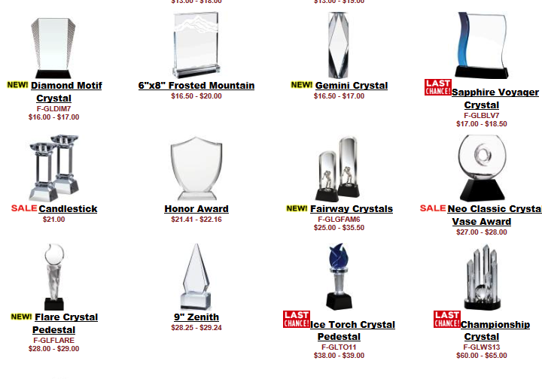
YOUR Suggestions…
Discontinued Heads Up

Slide 27
YOUR Suggestions…
Rethink categorizing medal ribbons in flex list to speed up order process.
COMPLETE!
RWB Neck Ribbons
Exclusive Sport Neck Ribbons
7/8” Colored Neck Ribbons
1 ½” Colored Neck Ribbons
Pin Drapes

Slide 28
YOUR Suggestions…
Ribbon Flex Lists

Slide 29
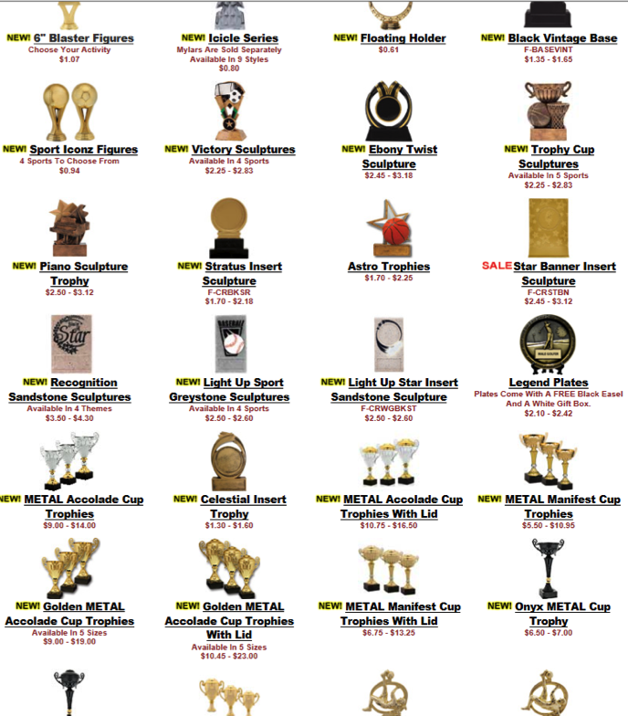
YOUR Suggestions…
Consolidation in the categories
Trophies, Crystal and Acrylics Are Complete
Trophies Before

Slide 30
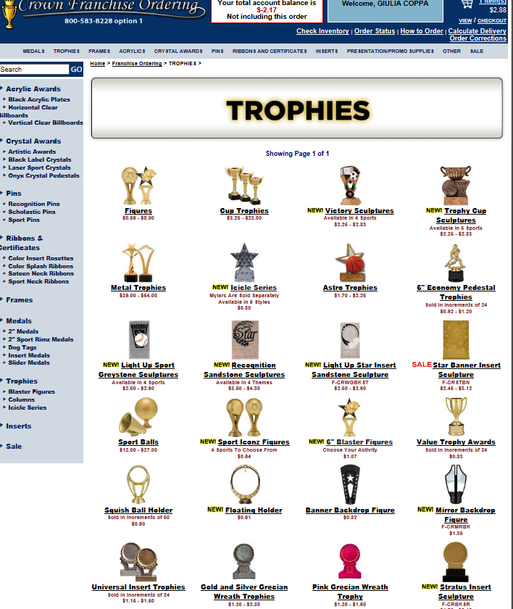
YOUR Suggestions…
Trophies Now – Cups Combined, Figures Combined, Resin Sport Balls Combined, etc

Slide 31
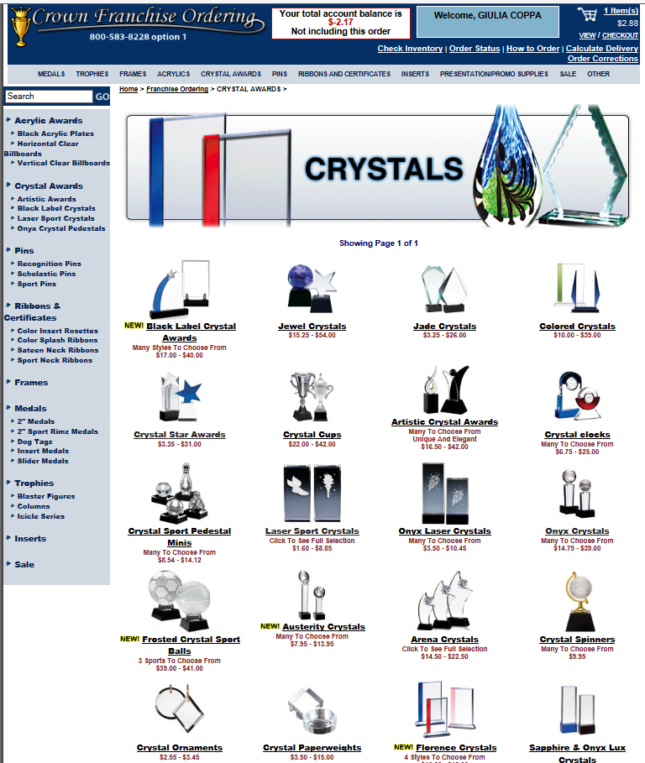
YOUR Suggestions…
Crystal Now – Onyx 3D Laser Combined, Star Crystal Combined, Jade Crystal Combined, etc

Slide 32
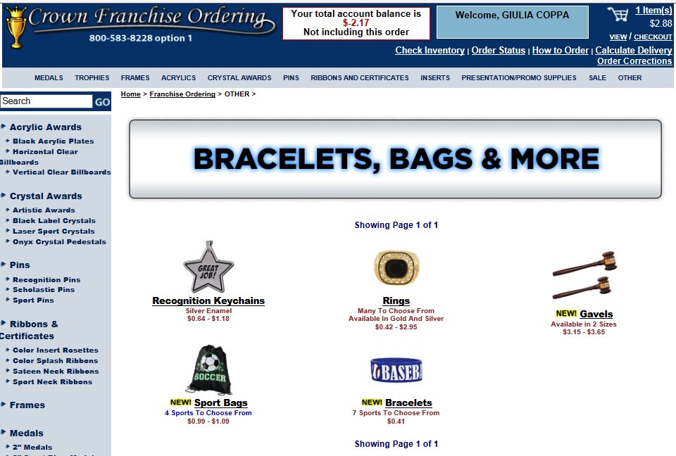
YOUR Suggestions…
Add An “OTHER” top level
Complete!

Slide 33
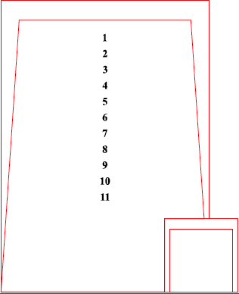
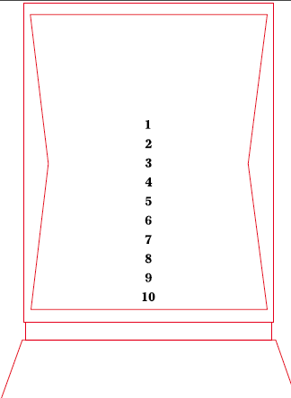
YOUR Suggestions…
Add Engraving Area for each piece
Looking into adding a link for the engrave lab template to the product page…
WE WILL KEEP YOU POSTED!

Slide 34
YOUR Suggestions…
Have the base show up with the item every time.
In progress
Flex list
Cross Sell

Slide 35
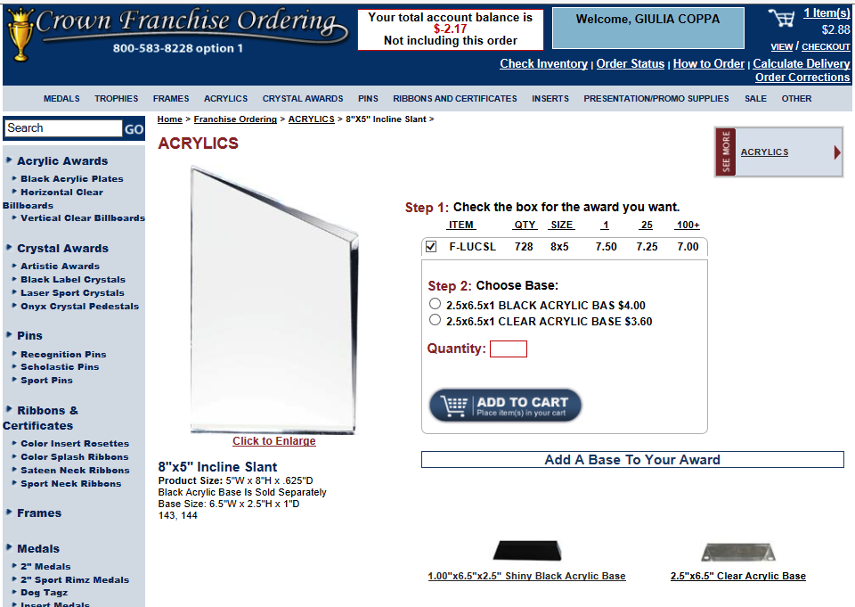
YOUR Suggestions…
Add A Base Easily!

Slide 36
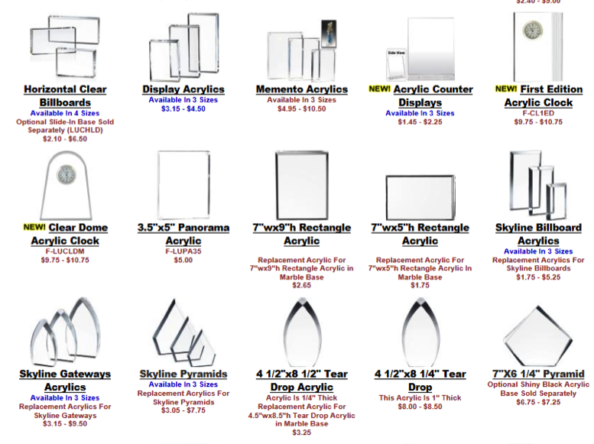
YOUR Suggestions…
Replacement parts, should be clearly marked or identified as replacement part
These items are already labeled in category text but…

Slide 37
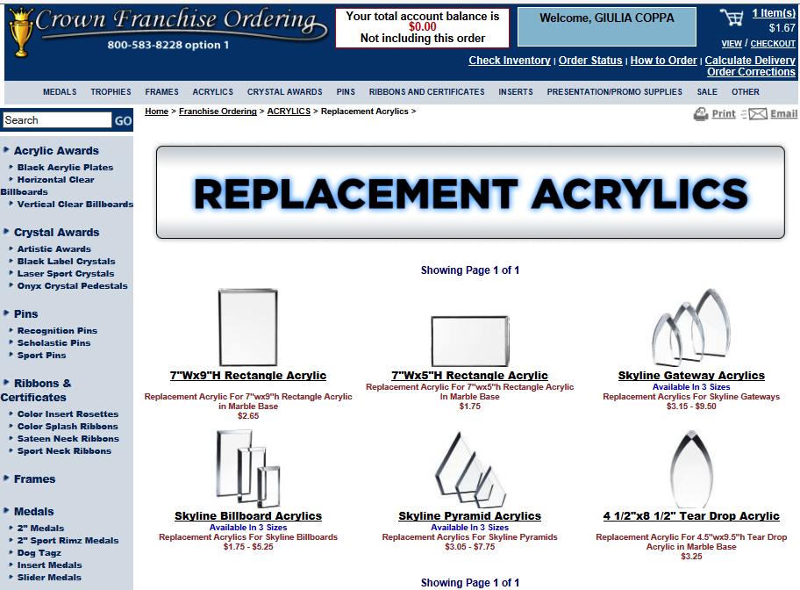
YOUR Suggestions…
New subcategory within Acrylics called “Replacement Acrylics” to easily find the awards online - COMPLETE

Slide 38
YOUR Suggestions…
Some items, that are more accessories like opti light up bases, don’t have an item number in the catalog or website, and aren’t with the opti’s on ordering website
Adding the item in the subcategory of the 3D Laser
Adding as a Cross sell item

Slide 39
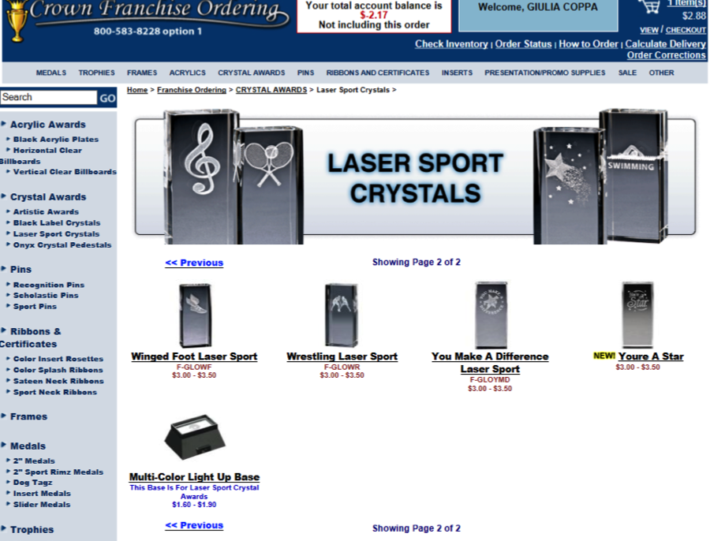
YOUR Suggestions…
Subcategory update – Complete!

Slide 40
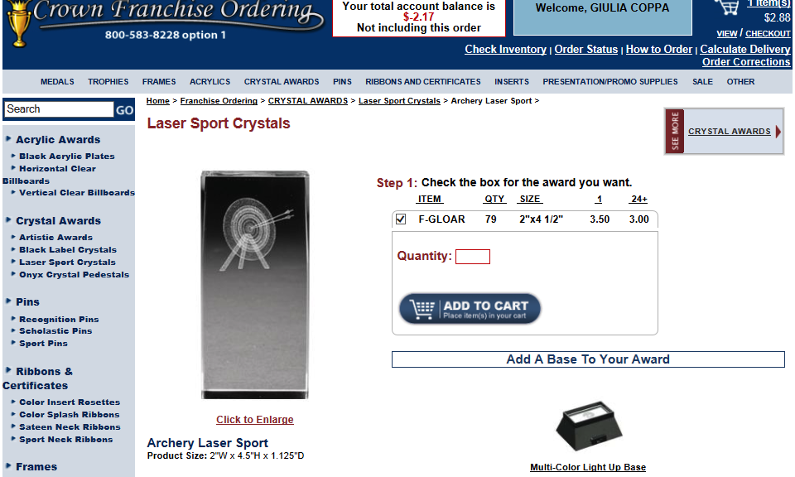
YOUR Suggestions…
Cross Sell Update – Complete!

Slide 41
YOUR Suggestions…
Link CA item numbers, CT item numbers, ordering item numbers and CFO item #s
COMPLETE on CFO Search

Slide 42
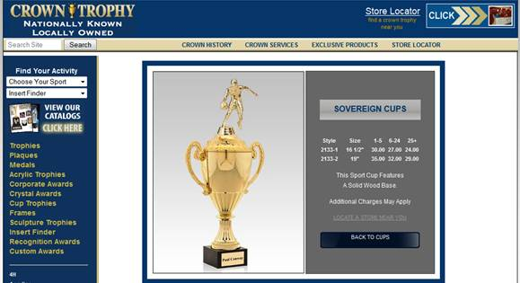
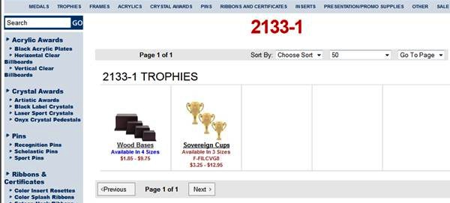
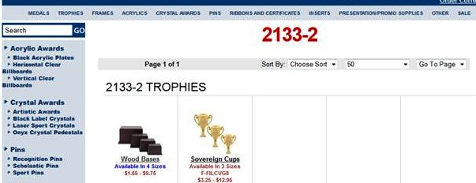
YOUR Suggestions…

Slide 43
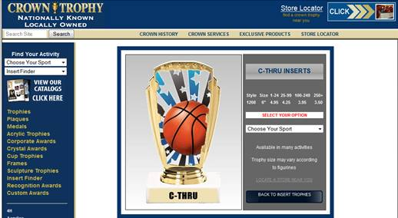
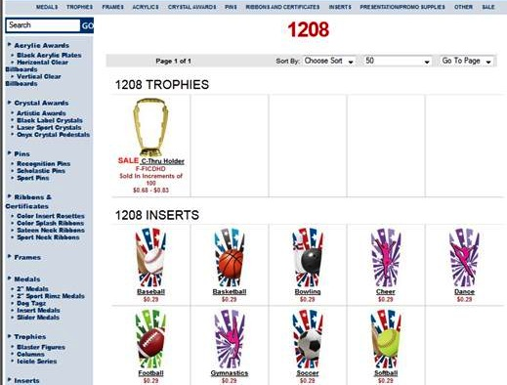
YOUR Suggestions…

Slide 44
YOUR Suggestions…
Make sure the item sizes match the ones on the website
Improving the coordination between Crown Franchise ordering Team and Crown Trophy Team
New Procedure Implemented!

Slide 45
YOUR Suggestions…
A uniform broken case qty. and price for all trophy parts?
Working on all items within a product line to have the same Case Quantity
All Plastic Figures will be sold in Case qty – 25
All Squish Balls will be sold in Case qty – 50
All Resins will be sold in Case qty – 24
ALL 2” MYLARS NOW SOLD IN Case qty – 20
Reviewing all case qty to confirm

Slide 46
YOUR Suggestions…
Add the following description: removable lid on Item # F-CPRS-G
Complete! In IMS

Slide 47
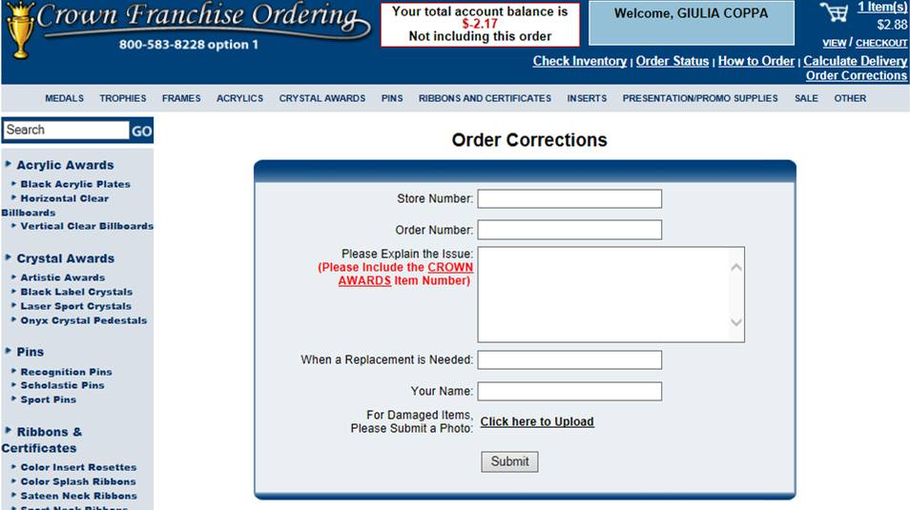
YOUR Suggestions…
Correction Form

Slide 48
Owners,
We asked for your:
Feedback
Suggestions
Ideas
And Now it’s time for our continued:
Implementation
THANK YOU!

